Slide 1
Tin Whisker Risk Model Spreadsheet
Quick Start Guide

Slide 2
Introduction
The Whisker Risk Model Spreadsheet can be used to calculate the expected number of tin whisker shorts on one or more leaded components, based on user-specified part and lead geometry, whisker density, whisker length distribution, applied voltage, and conformal coating coverage.
This presentation describes a worked example. To follow along, download the Whisker Risk Model Example Excel spreadsheet at http://www.calce.umd.edu/tin-whiskers/spreadsheet/.
For further details, see the Whisker Risk Model Spreadsheet User Guide, also available at the same URL.

Slide 3
Example: 14-lead SOIC Part
You have been asked to determine the expected number of tin whisker shorts for a 14-lead SOIC part.
You will specify the part and lead geometry.
You will then enter the whisker length distributions.

Slide 4
Part and Lead Geometry
Package Height (A₂) = 1.75 mm
Package Seating Plane (A₁) = 0.18 mm
Lead Span (H) = 6.00 mm
Body Width (E) = 3.90 mm
Lead Foot Length (L) = 0.75 mm
Lead Thickness (c) = 0.20 mm
Lead Width (B) = 0.43 mm
Lead Pitch (e) = 1.25 mm
Lead Angle from Vertical (α) = 10 degrees
Number of Leads = 14
Number of Sides with Leads = 2

Slide 5
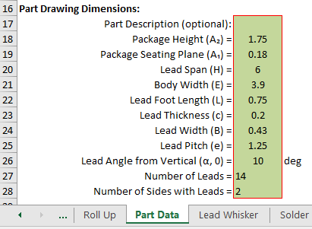
Enter Geometry
Open the spreadsheet and navigate to the Part Data sheet.
Enter geometry data as shown in the green cells:

Slide 6
Enter Whisker Density and Length Distribution
In the Lead Whisker, Solder Whisker, and Pad Whisker sheets:
Enter 400 for the whisker density.
Enter 2 for Distribution, indicating a lognormal distribution.
Enter 0 for Whisker Minimum.
Enter 0.31 for Whisker μ (location) parameter.
Enter 0.88 for Whisker σ (scale) parameter.
Remember to enter these values for each of the three sheets.

Slide 7
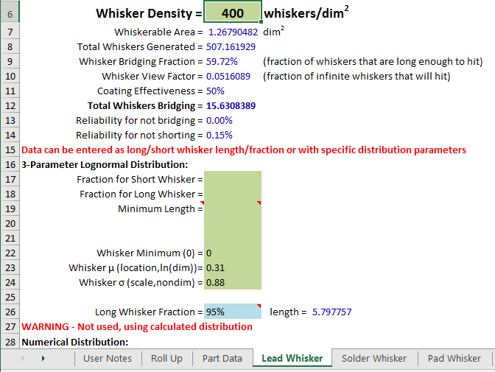

Slide 8
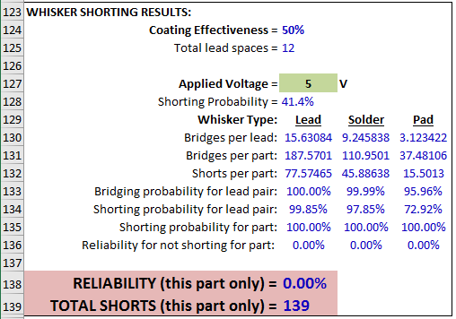
Results
Return to the Part Data sheet. Leave default values for applied voltage (5V), PWB Pad Thickness (0.063 mm), and Overall Coating Effectiveness (50%).
The final result, 139 expected shorts, and the reliability for not shorting (the prob. that no shorts form – 0.00%), is displayed at the bottom of the sheet:

Slide 9
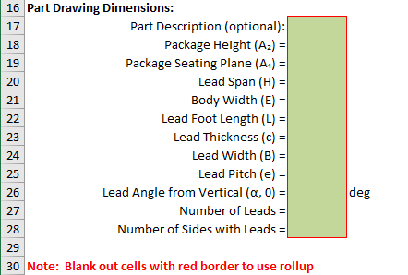
Roll Up Sheet (Part 1)
Now you will use the Roll Up Sheet to analyze an assembly with more than one part.
First, blank out the values in Part Drawing Dimensions section of the Part Data sheet:

Slide 10
Roll Up Sheet (Part 2)
Fill out the Roll Up sheet as shown, and press Shift-F9 when ready to calculate the OVERALL TOTAL SHORTS expected across all seven components:
The overall total shorts in this case is expected to be 5,227.
The overall reliability for no shorts forming is 0.00%.

